Slide 1
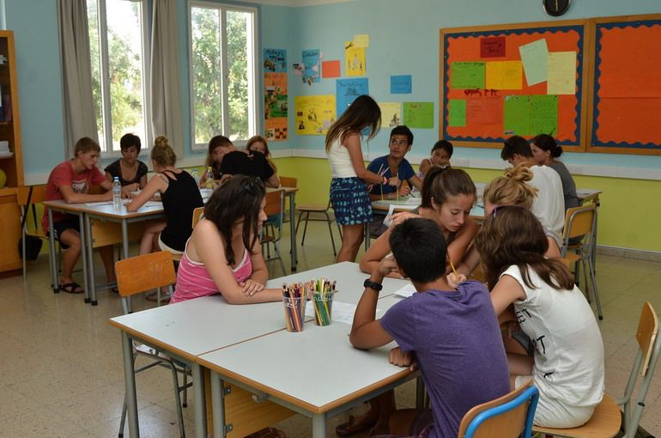
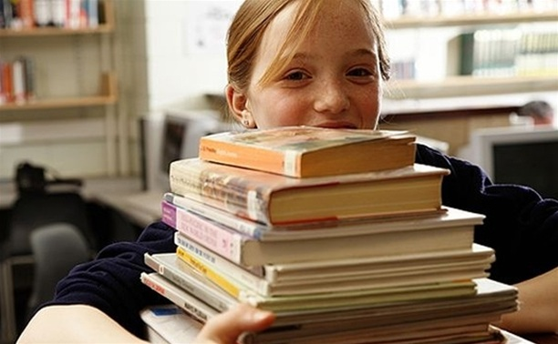

Slide 2
Where can we get education from?
Education

Slide 3
School is the place to… | provide oneself with… select pupils according to… test oneself in all sorts of...
Learning is fun when it(is)… | available not dull varies relevant (to modern life)
A good education helps… | to develop a personality to find a place in society to guarantee good wages
The greatest thing at school is to learn... | to get along with… to get much information to study to carry on with studies
But some people have trouble at school because… | can’t cope with… don’t keep(them) interested far from real life don’t consider worth-while…
I believe… I’m convinced that… Actually…
What I’m trying to say is…

Slide 4
Give synonyms to the words:
grade -
to be located –
primary school –
public school –
comprehensive school –
Give the opposites to the following:
mixed school –
fee-paying –
core subjects –
to be at school –
independent school –

